Slide 1

Original Presentation by Team Griffdog, Donut Steal!

Slide 2
Team Griffdog – who we are
We are team griffdog , we all come from Richard Lander and we teamed up for mission to mars.
Our names are:
Luc “Legend” Hutton
Joshua “Not-So-Royal” King
Billy “Da Bomb” Tunnicliffe
Rolands “God” Shine
Lily “she who doesn’t have a nickname” Martin

Slide 3
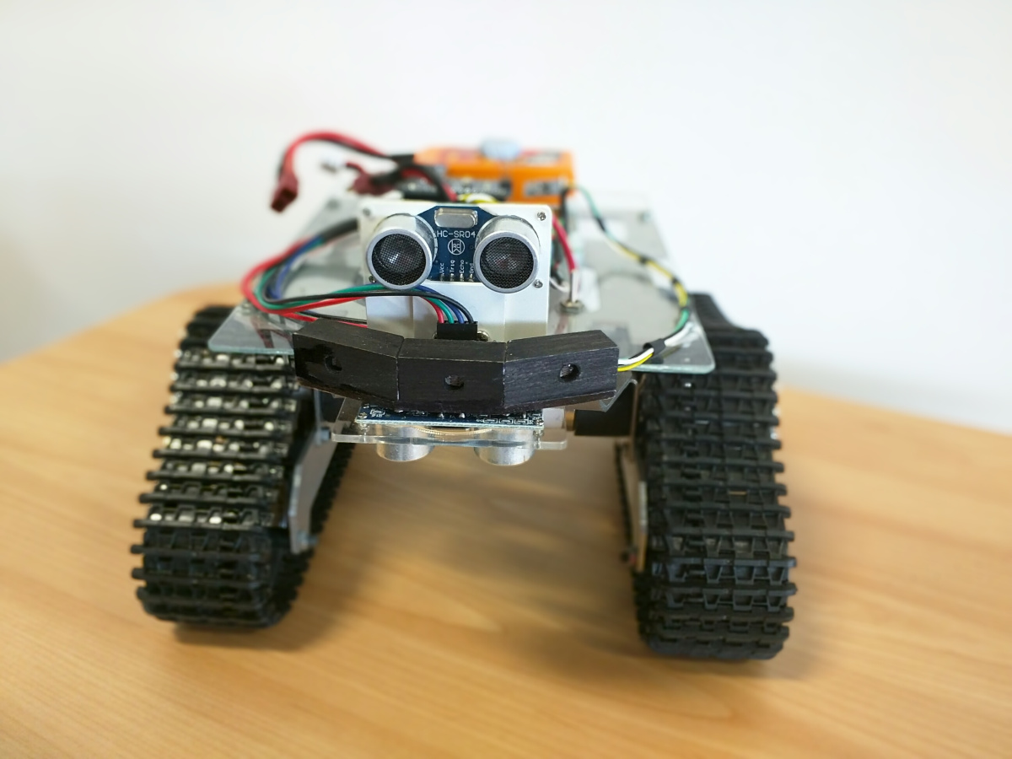
What we have done for this project
During our week at work experience we coded a rover to cary out certain functions. Each of these earned us more money so we could hire out the rover. Halfway through the week one member of the team met with an “investor”.

Slide 4
Mob programming
When we were designing the code we used a technique called mob programming. The people with the code idea had to tell someone else what to put in so everyone had a go at programming.

Slide 5
Rover Demo
We are going to now do a demo with our rover
We will make it preform these tasks:
Figure of 8
Collision test
Drop testing
Follow light

Slide 6
What could of gone better
When we used the rover we were making good use of it but we seemed to rush on some of the challenges meaning the rover’s code might have been not that good.

